Slide 1
NLP

Slide 2
Introduction to NLP
Part of Speech Tagging

Slide 3
The POS task
Example
Bahrainis vote in second round of parliamentary election
Jabberwocky (by Lewis Carroll, 1872)
`Twas brillig, and the slithy toves Did gyre and gimble in the wabe: All mimsy were the borogoves, And the mome raths outgrabe.

Slide 4
Parts of speech
Open class:
nouns, non-modal verbs, adjectives, adverbs
Closed class:
prepositions, modal verbs, conjunctions, particles, determiners, pronouns

Slide 5
Penn Treebank tagset (1/2)
Tag | Description | Example
CC | coordinating conjunction | and
CD | cardinal number | 1
DT | determiner | the
EX | existential there | there is
FW | foreign word | d‘oeuvre
IN | preposition/subordinating conjunction | in, of, like
JJ | adjective | green
JJR | adjective, comparative | greener
JJS | adjective, superlative | greenest
LS | list marker | 1)
MD | modal | could, will
NN | noun, singular or mass | table
NNS | noun plural | tables
NNP | proper noun, singular | John
NNPS | proper noun, plural | Vikings
PDT | predeterminer | both the boys
POS | possessive ending | friend's

Slide 6
Penn Treebank tagset (2/2)
Tag | Description | Example
PRP | personal pronoun | I, he, it
PRP$ | possessive pronoun | my, his
RB | adverb | however, usually, naturally, here, good
RBR | adverb, comparative | better
RBS | adverb, superlative | best
RP | particle | give up
TO | to | to go, to him
UH | interjection | uhhuhhuhh
VB | verb, base form | take
VBD | verb, past tense | took
VBG | verb, gerund/present participle | taking
VBN | verb, past participle | taken
VBP | verb, sing. present, non-3d | take
VBZ | verb, 3rd person sing. present | takes
WDT | wh-determiner | which
WP | wh-pronoun | who, what
WP$ | possessive wh-pronoun | whose
WRB | wh-abverb | where, when

Slide 7
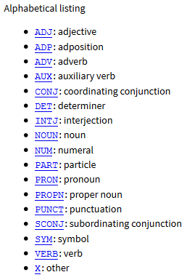
Universal POS
http://universaldependencies.org/u/pos/

Slide 8
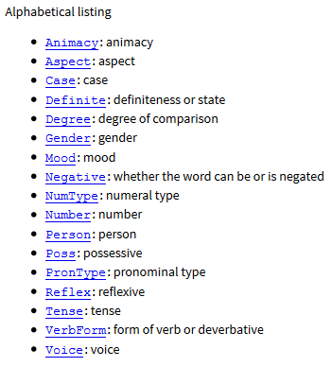
Universal Features
http://universaldependencies.org/u/feat/

Slide 9
Some Observations
Ambiguity
count (noun) vs. count (verb)
11% of all types but 40% of all tokens in the Brown corpus are ambiguous.
Examples
like can be tagged as ADP VERB ADJ ADV NOUN
present can be tagged as ADJ NOUN VERB ADV

Slide 10
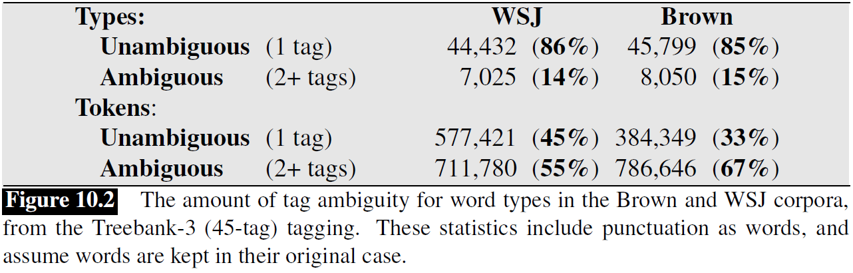
POS Ambiguity
Example from J&M

Slide 11
Some Observations
More examples:
transport, object, discount, address
content
French pronunciation:
est, président, fils
Three main techniques:
rule-based
machine learning (e.g., conditional random fields, maximum entropy Markov models, neural networks)
transformation-based
Useful for parsing, translation, text to speech, word sense disambiguation, etc.

Slide 12
Example
Bethlehem/NNP Steel/NNP Corp./NNP ,/, hammered/VBN by/IN higher/JJR costs/NNS
Bethlehem/NNP Steel/NNP Corp./NNP ,/, hammered/VBN by/IN higher/JJR costs/VBZ

Slide 13
Classifier-based POS Tagging
A baseline method would be to use a classifier to map each individual word into a likely POS tag
Why is this method unlikely to work well?

Slide 14
Sources of Information
Bethlehem/NNP Steel/NNP Corp./NNP ,/, hammered/VBN by/IN higher/JJR costs/NNS
Bethlehem/NNP Steel/NNP Corp./NNP ,/, hammered/VBN by/IN higher/JJR costs/VBZ
Knowledge about individual words
lexical information
spelling (-or)
capitalization (IBM)
Knowledge about neighboring words

Slide 15
Evaluation
Baseline
tag each word with its most likely tag
tag each OOV word as a noun.
around 90%
Current accuracy
around 97% for English
compared to 98% human performance

Slide 16
Rule-based POS tagging
Use dictionary or finite-state transducers to find all possible parts of speech
Use disambiguation rules
e.g., ART+V
Hundreds of constraints need to be designed manually

Slide 17
Example in French
<S> ^ beginning of sentence
La rf b nms u article
teneur nfs nms noun feminine singular
moyenne jfs nfs v1s v2s v3s adjective feminine singular
en p a b preposition
uranium nms noun masculine singular
des p r preposition
rivières nfp noun feminine plural
, x punctuation
bien_que cs subordinating conjunction
délicate jfs adjective feminine singular
à p preposition
calculer v verb

Slide 18
Sample Rules
BS3 BI1
A BS3 (3rd person subject personal pronoun) cannot be followed by a BI1 (1st person indirect personal pronoun).
In the example: “il nous faut” (= “we need”) – “il” has the tag BS3MS and “nous” has the tags [BD1P BI1P BJ1P BR1P BS1P].
The negative constraint “BS3 BI1” rules out “BI1P'', and thus leaves only 4 alternatives for the word “nous”.
N K
The tag N (noun) cannot be followed by a tag K (interrogative pronoun); an example in the test corpus would be: “... fleuve qui ...” (...river that...).
Since “qui” can be tagged both as an “E” (relative pronoun) and a “K” (interrogative pronoun), the “E” will be chosen by the tagger since an interrogative pronoun cannot follow a noun (“N”).
R V
A word tagged with R (article) cannot be followed by a word tagged with V (verb): for example “l' appelle” (calls him/her).
The word “appelle” can only be a verb, but “l'” can be either an article or a personal pronoun.
Thus, the rule will eliminate the article tag, giving preference to the pronoun.

Slide 19
NLP

